Slide 1
Lawrenceville City-Split
Gwinnett County

Slide 2
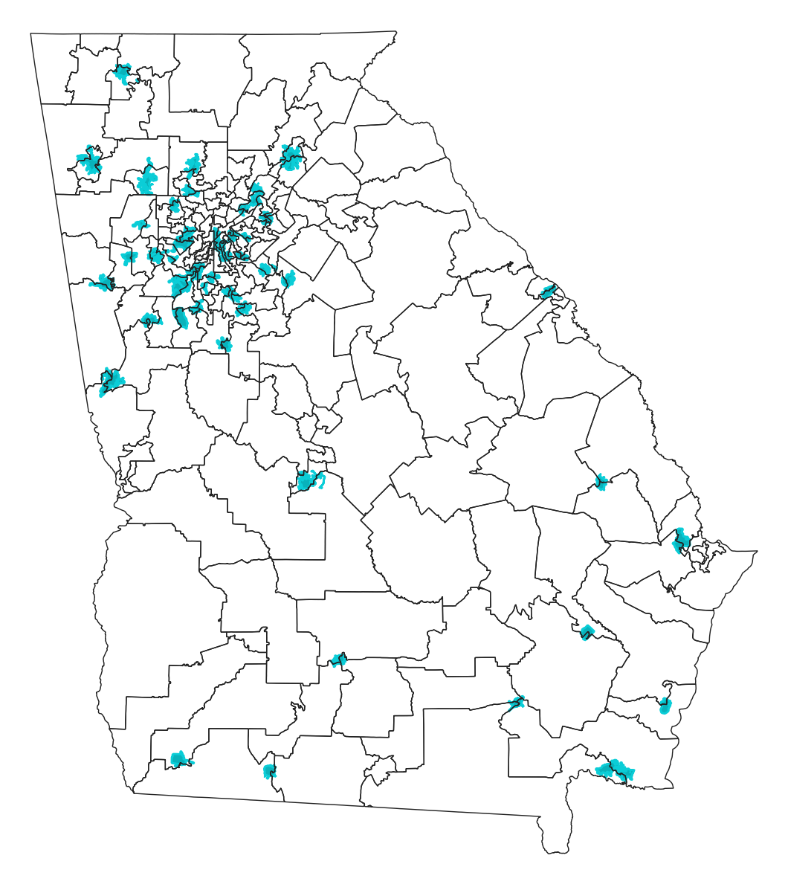
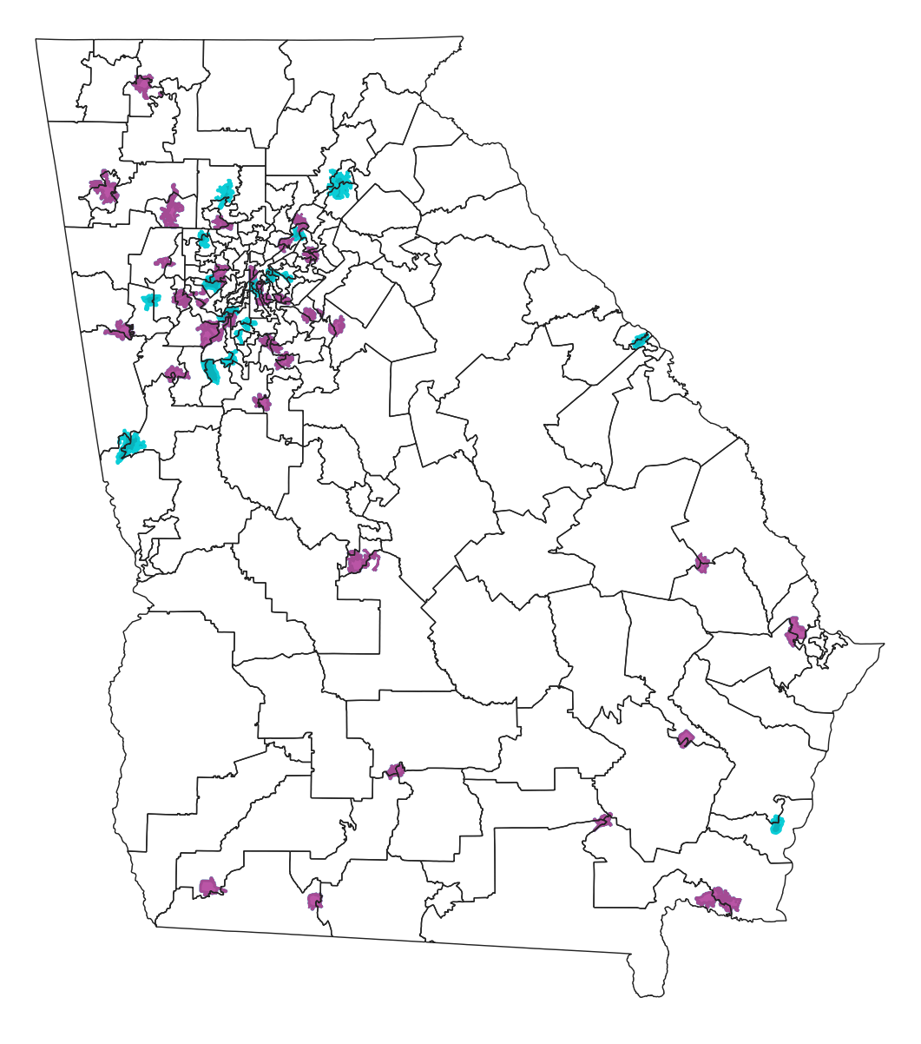
The 2011/12 State House Map Cracked Small Cities
cities cracked before 2011
Two-thirds of small cities
are cracked into multiple House districts
cities cracked in 2011 redistricting
The number of small cities cracked into multiple districts increased by 44% in the 2011 decennial House redistricting
Notes:
The 2011 House map, drawn by Republicans, divided many more small cities across the state. So that is cities with at least 10,000 people but smaller than a House District (54,000)
Cities have distinct needs and should be able to have a distinct voice.
But of the 81 small cities in Georgia, two thirds are split into multiple House districts.
This was much, much lower when the courts drew the boundaries.
The number of small cities split into more districts by the House map increased by 44% under the 2011 map.

Slide 3
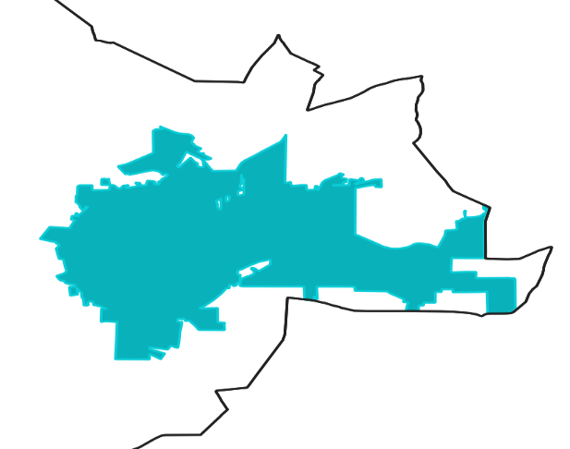
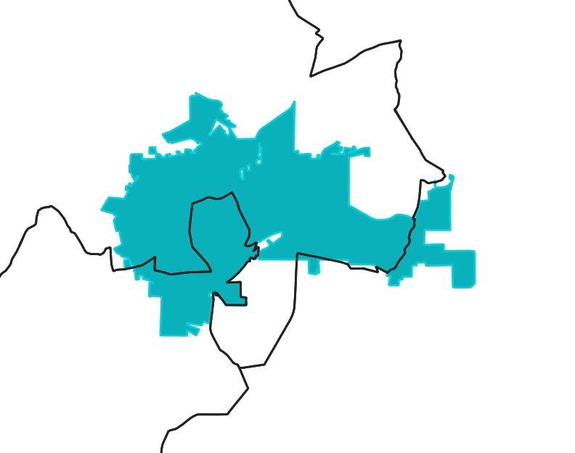
Newnan Cracked into 3 House Districts
2010—before redistricting
2011—after redistricting
Newnan
Newnan
70
70
71
132
Newnan pop (2010) = 33,000
Average district (2010) = 53,820
Newnan pop (2019) = 41,500
Average district (2021) = 59,500
Source: FDGA analysis
Notes:
Like Newnan, which was represented by 1 house district in 2010, but was split into 3 districts after the GOP redrew the House map in 2011.

Slide 4
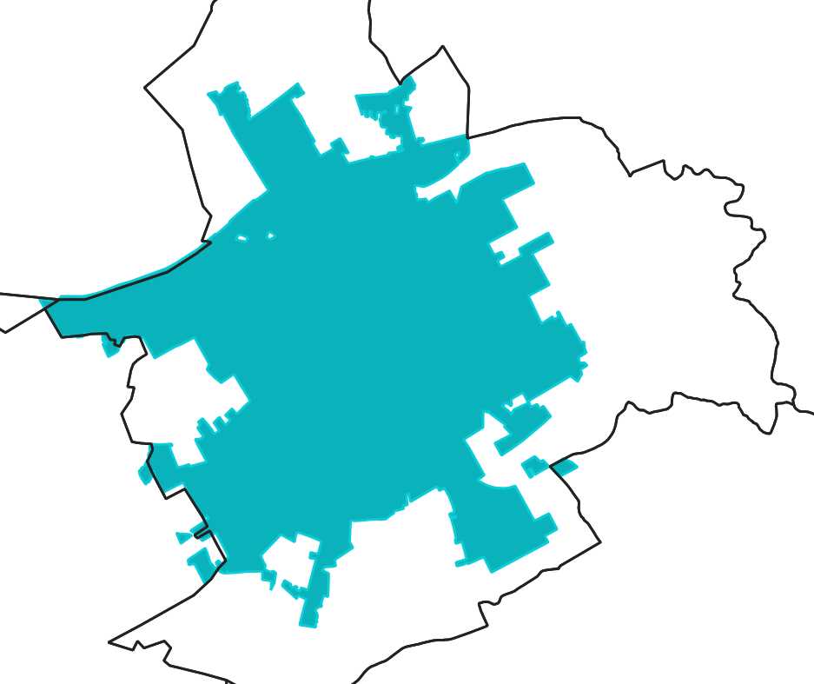
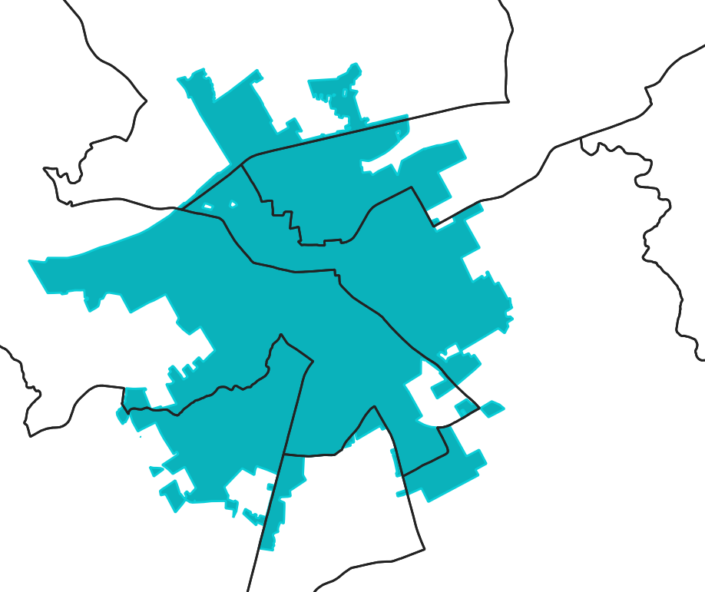
Lawrenceville Cracked into 6 House Districts
2010—before redistricting
2011—after redistricting
Lawrenceville
Lawrenceville
102
104
103
104
101
105
107
106
Notes:
Lawrenceville went from 1 house district in 2010 to 6 districts after the GOP redrew the House map in 2011.

Slide 5
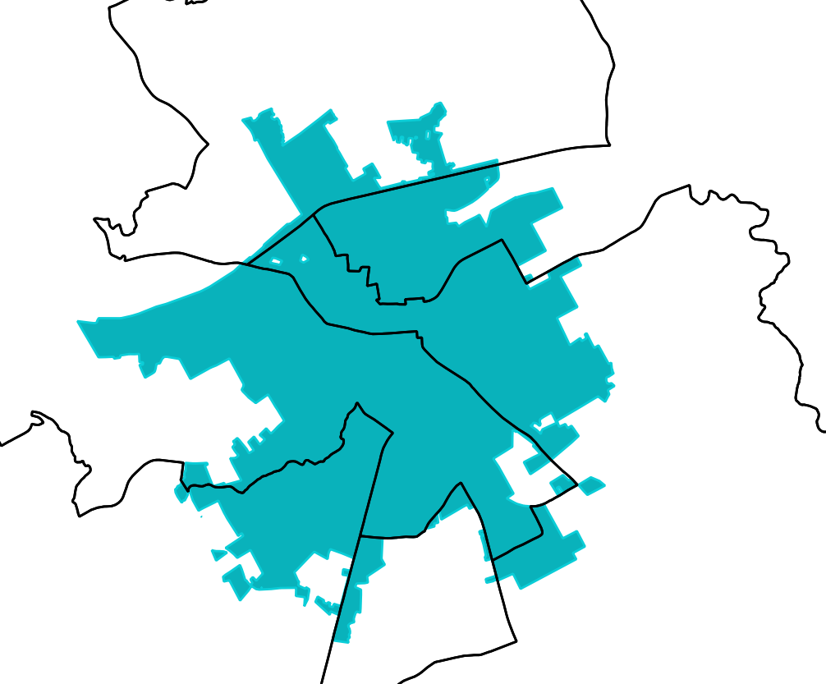
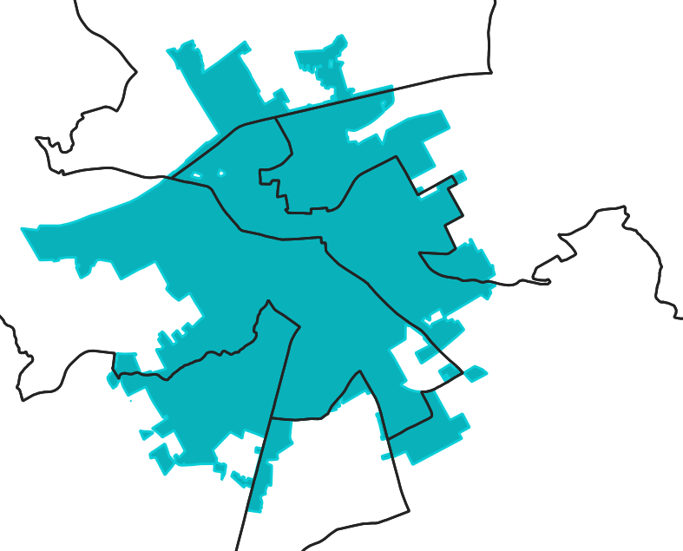
Lawrenceville Further Altered in 2012 and 2015
2012—mid-decade redistricting
2015—mid-decade redistricting
Lawrenceville
Lawrenceville
102
102
District 103 replaced by District 104
104
104
101
105
101
105
107
107
A proposed 2019 mid-decade alteration to HD 104 and HD 105 failed
106
106
Notes:
The 2011 map was never used in an election; it was superseded by the 2012 mid-decade redistricting, which maintained the number of districts but substituted HD 104 for HD 103, which was moved outside the city. In 2015, the GOP altered the boundaries of HD 104 and HD 105 in a mid-cycle adjustment. A proposed 2019 mid-decade redistricting bill was introduced to further alter HD 104 and HD 105, but failed.

